Slide 1

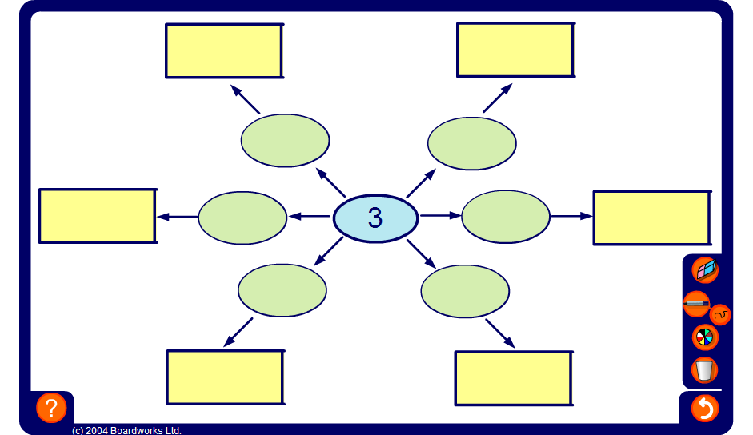


Spider diagram
Notes:
This activity illustrates the effect of multiplying and dividing decimals by 10, 100 and 1000.
Click on the green ovals to reveal the number inside.
Reset the activity to change the central number.

